Slide 1


1 / 13
LESSON 9 - TALL TREES AND BLUE SKIES
Hello!
LITTLE SEEDS! MONTH 1

Slide 2

Lesson 9 – Tall Trees and Blue Skies
2 / 13
Blue Sky
LITTLE SEEDS! MONTH 1

Slide 3

Lesson 9 – Tall Trees and Blue Skies
3 / 13
Tree
LITTLE SEEDS! MONTH 1

Slide 4
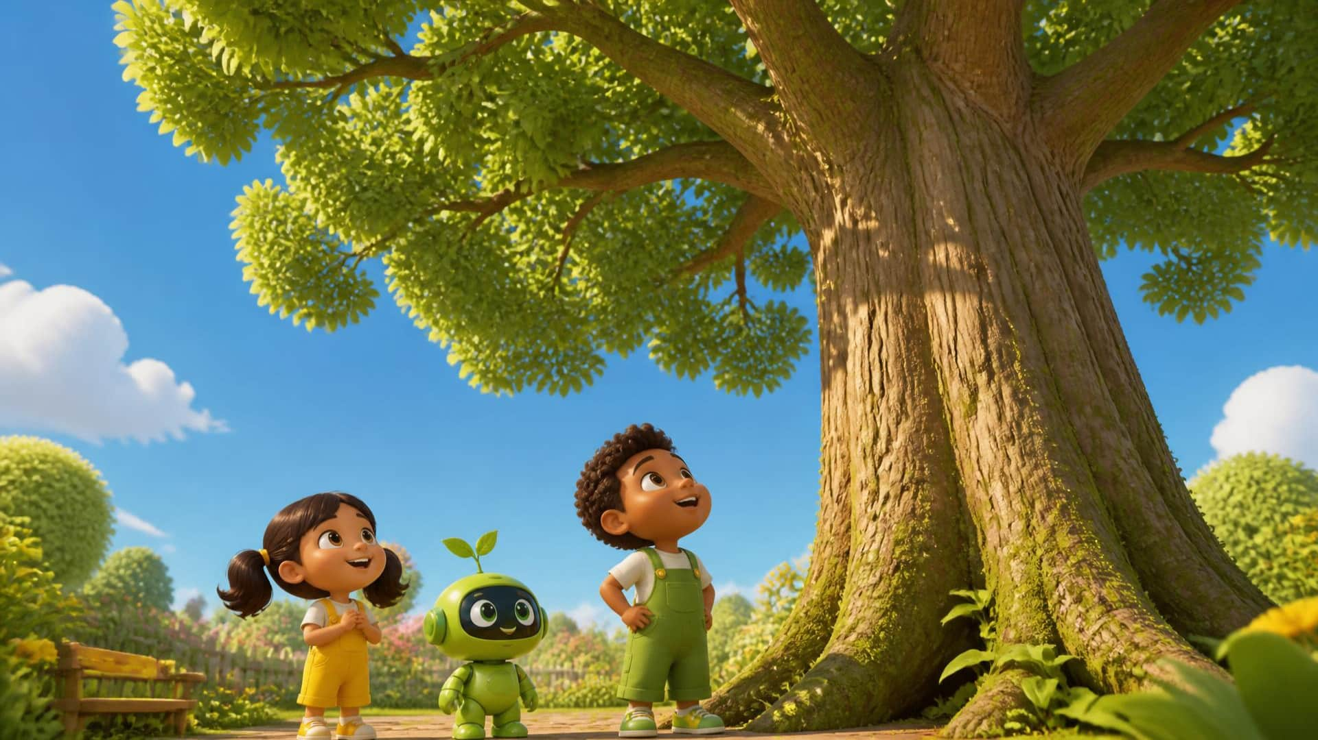
Lesson 9 – Tall Trees and Blue Skies
4 / 13
Tall
LITTLE SEEDS! MONTH 1

Slide 5
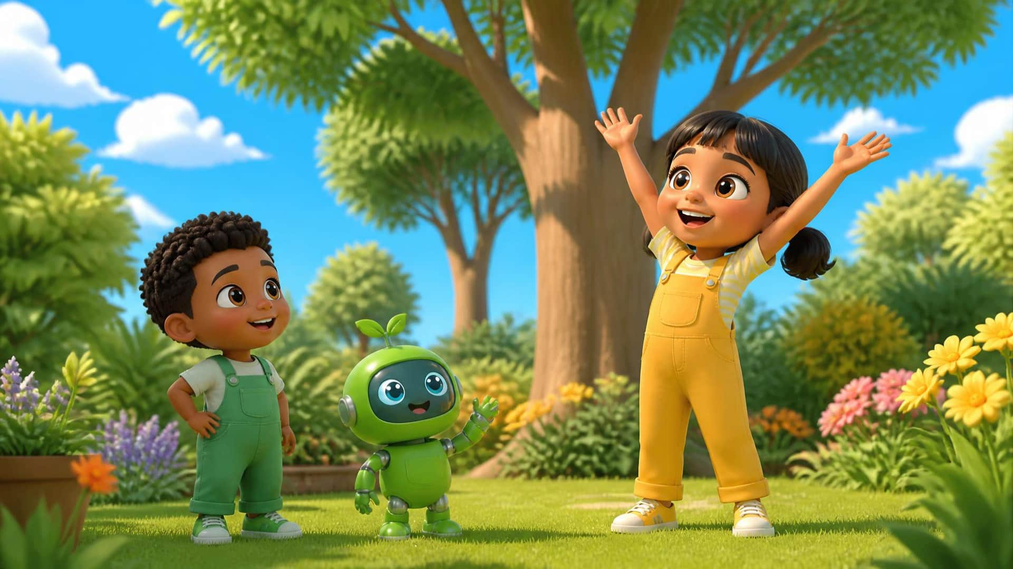
Lesson 9 – Tall Trees and Blue Skies
5 / 13
The tree is tall.
LITTLE SEEDS! MONTH 1

Slide 6
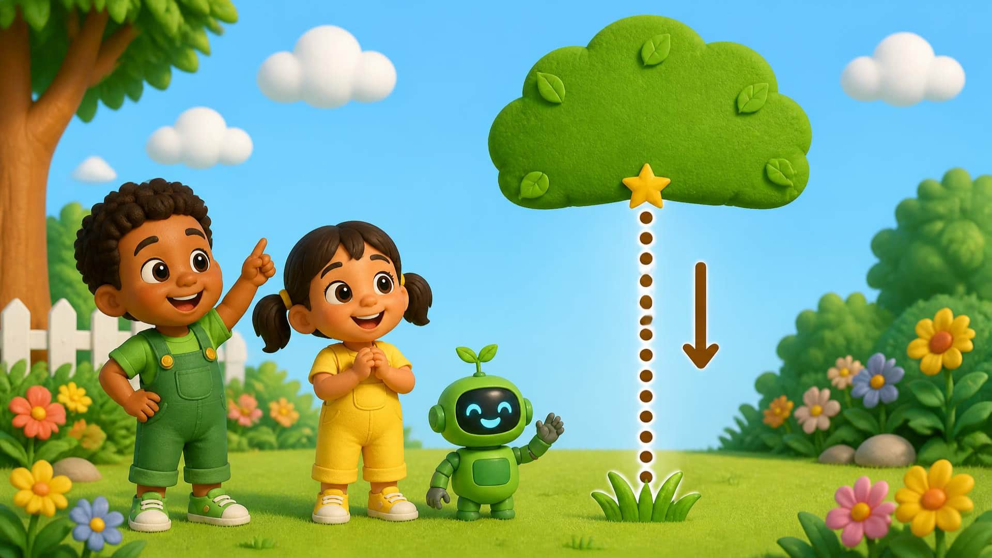
Lesson 9 – Tall Trees and Blue Skies
6 / 13
Trace down.
LITTLE SEEDS! MONTH 1

Slide 7

Lesson 9 – Tall Trees and Blue Skies
7 / 13
Draw the trees.
LITTLE SEEDS! MONTH 1

Slide 8

Lesson 9 – Tall Trees and Blue Skies
8 / 13
Love the trees.
LITTLE SEEDS! MONTH 1

Slide 9
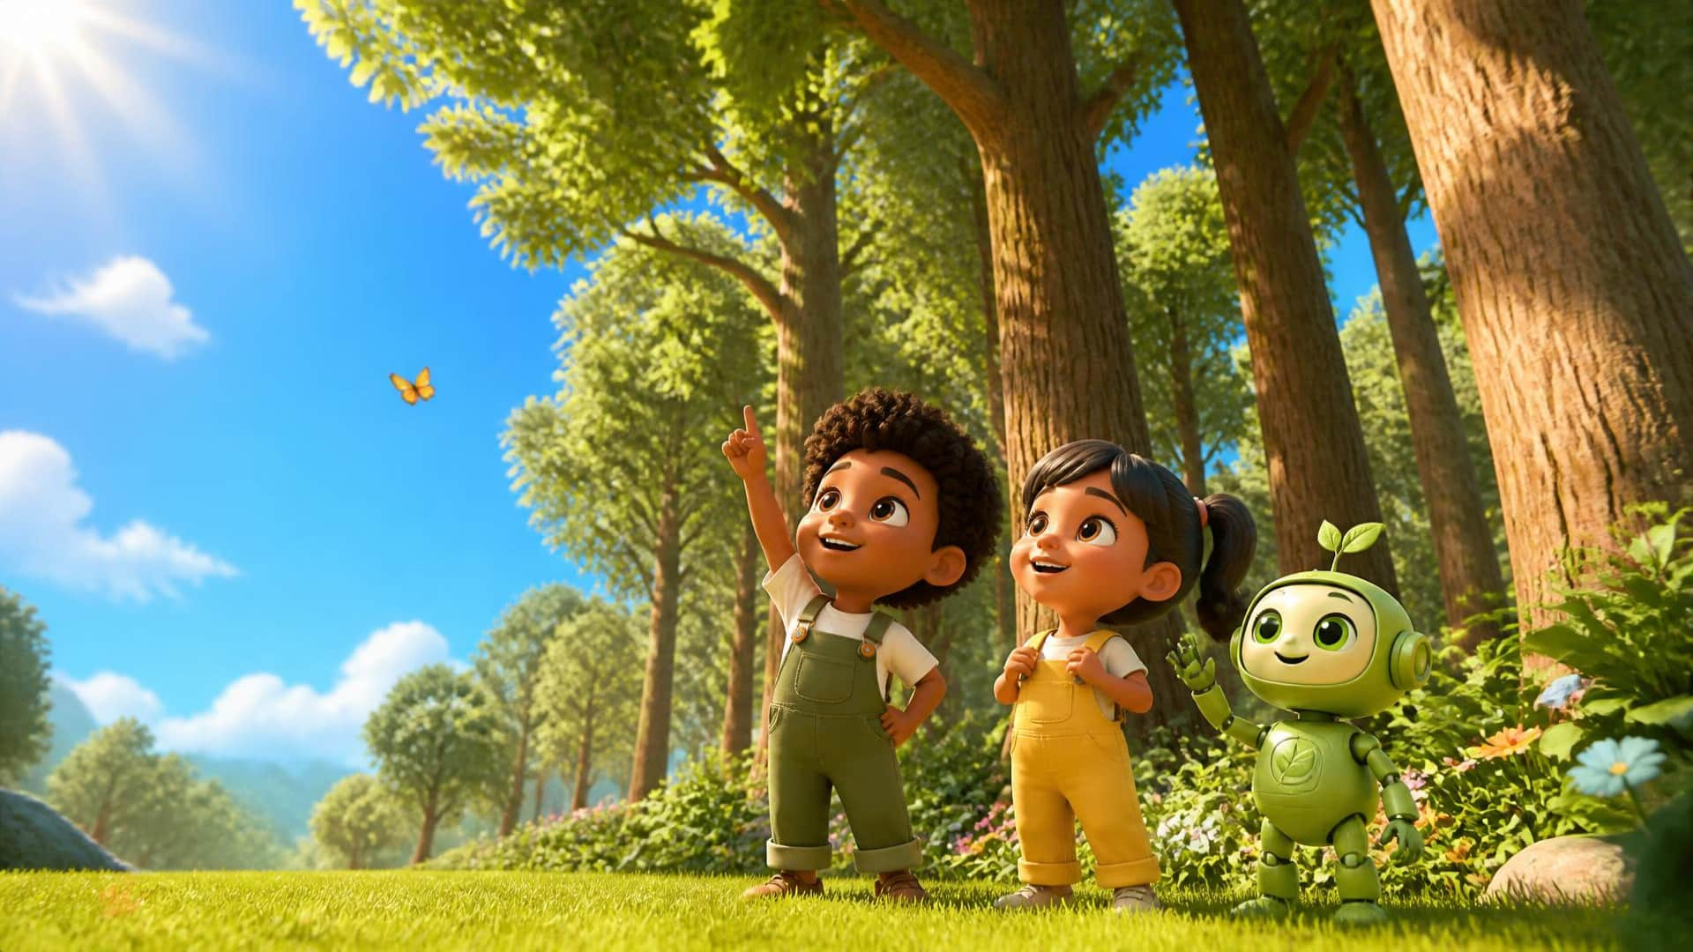
Lesson 9 – Tall Trees and Blue Skies
9 / 13
God made tall trees.
LITTLE SEEDS! MONTH 1

Slide 10
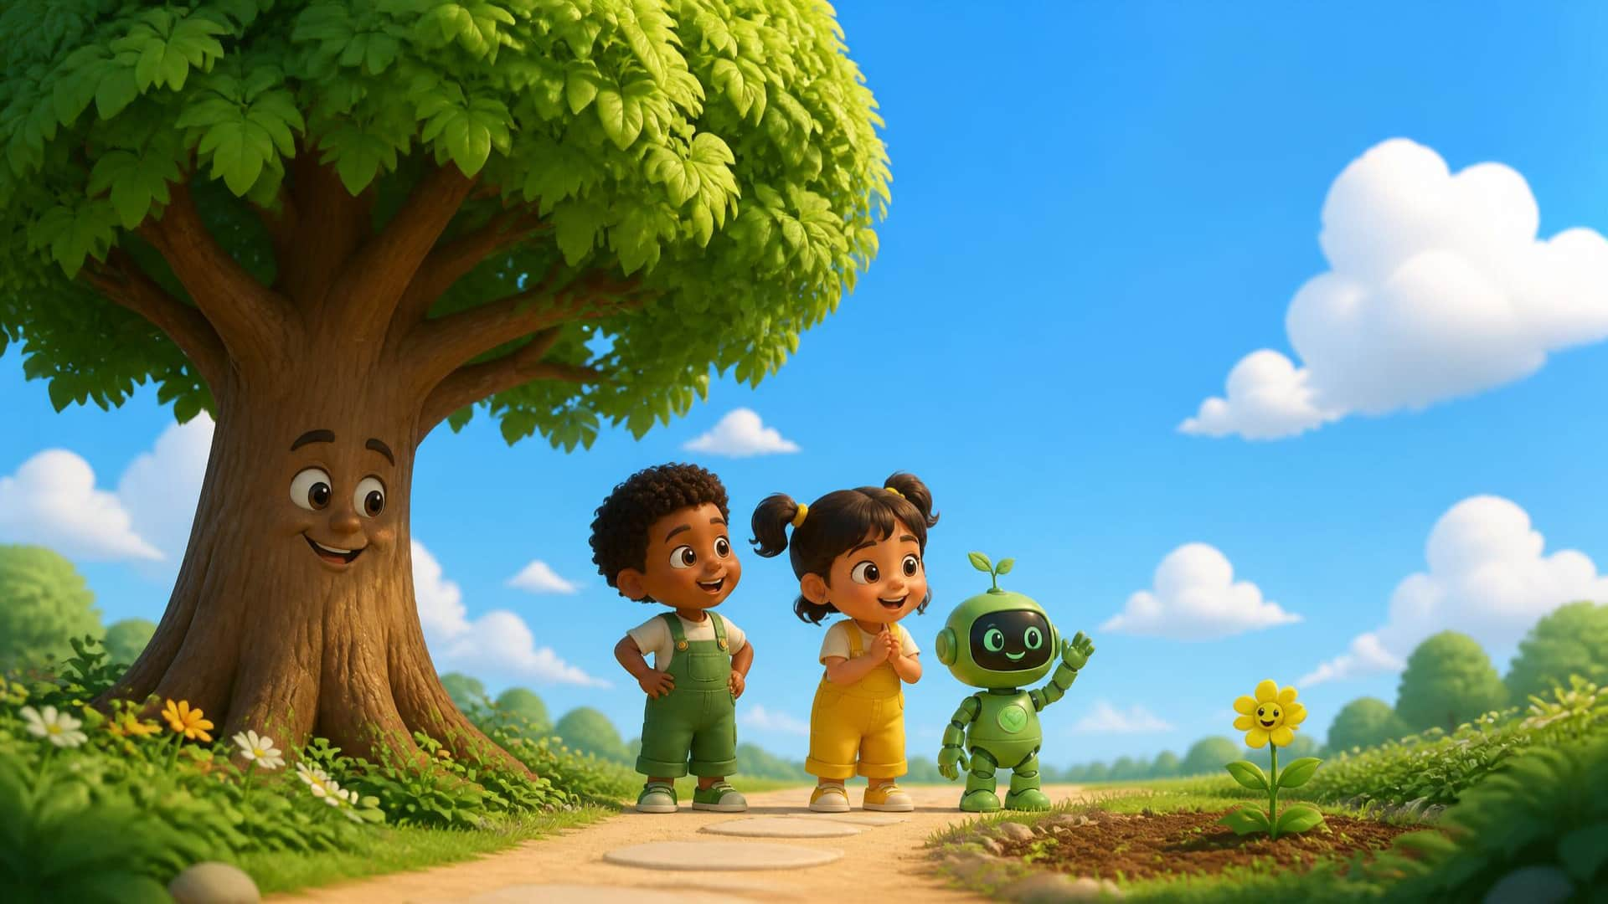
Lesson 9 – Tall Trees and Blue Skies
10 / 13
Which is tall?
LITTLE SEEDS! MONTH 1

Slide 11
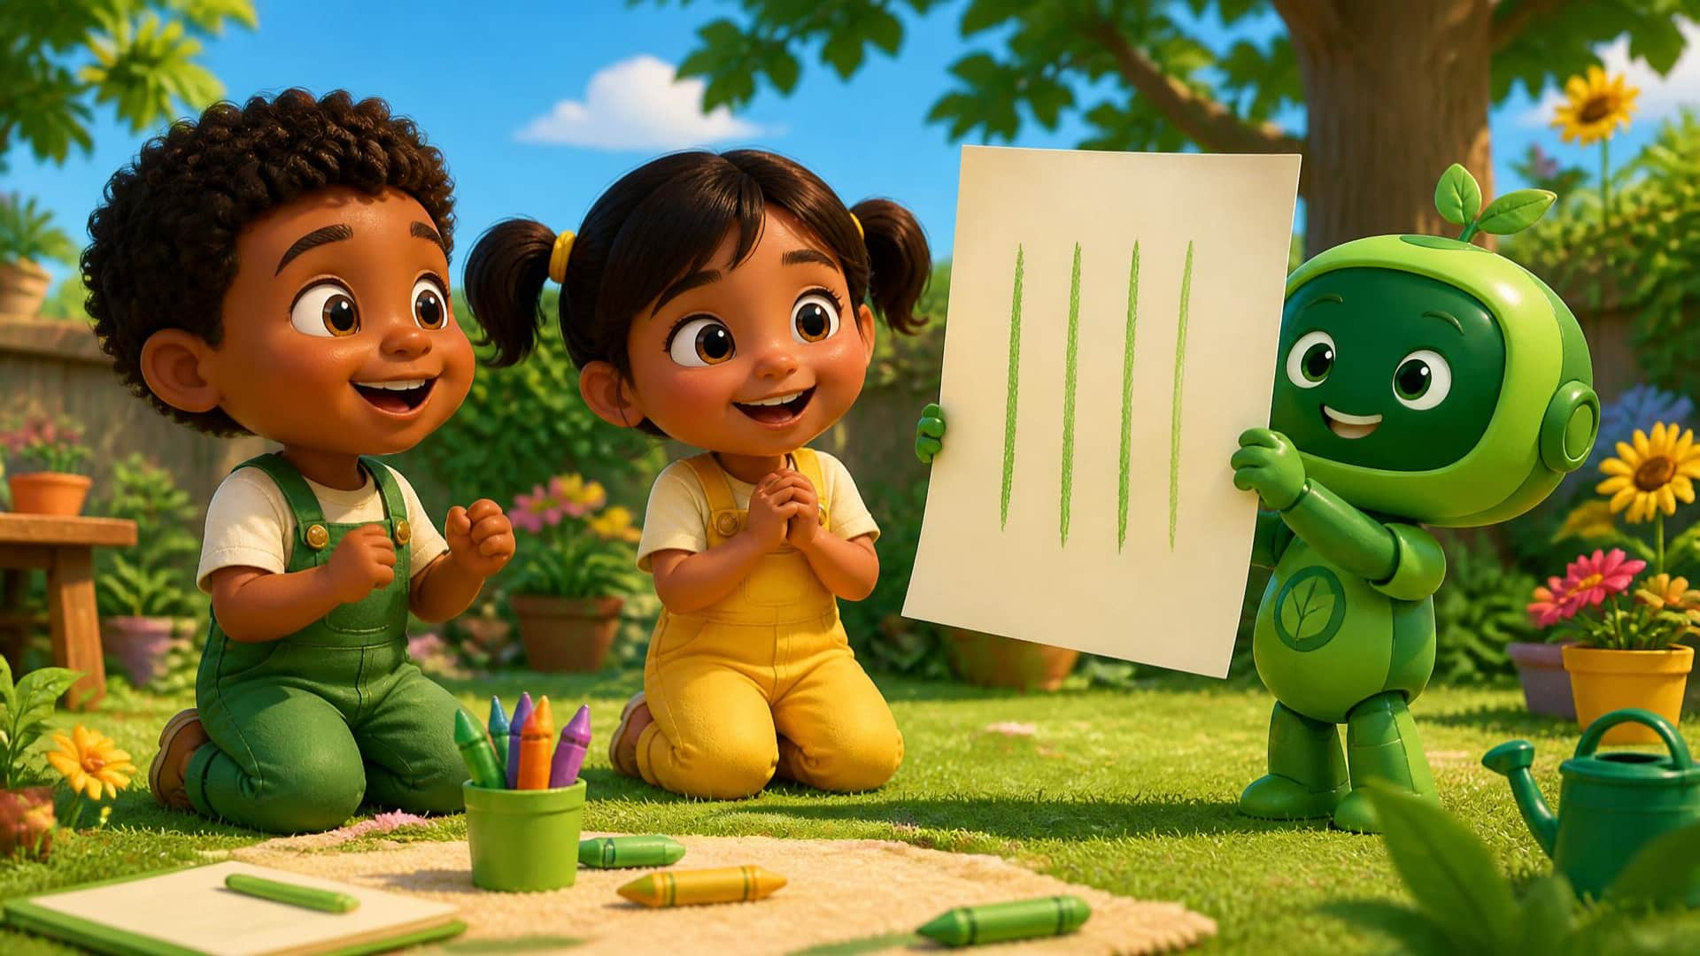
Lesson 9 – Tall Trees and Blue Skies
11 / 13
Your turn!
LITTLE SEEDS! MONTH 1

Slide 12

Lesson 9 – Tall Trees and Blue Skies
12 / 13
Blue Sky.
Tall Tree.
LITTLE SEEDS! MONTH 1

Slide 13

Lesson 9 – Tall Trees and Blue Skies
13 / 13
Goodbye!
LITTLE SEEDS! MONTH 1

